Slide 1
Diffusion-Limited Aggregation

Slide 2
1
Introduction
2
Methodology
3
Analysis
4
Results
5
Conclusion

Slide 3
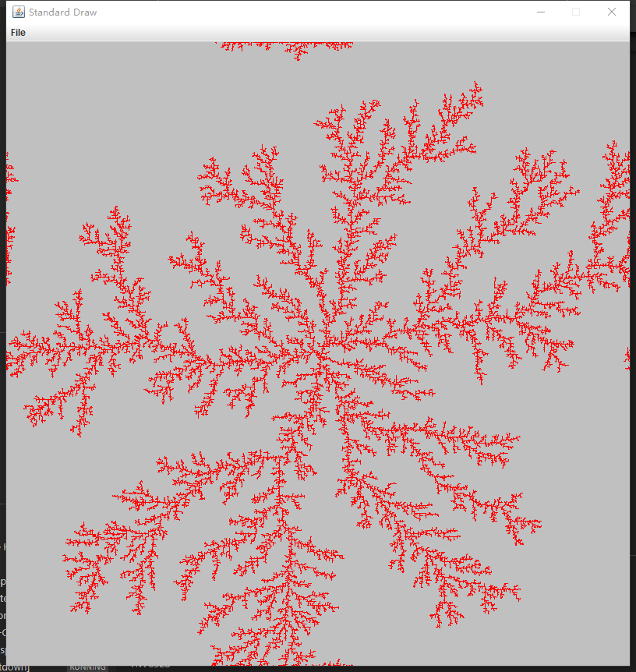
1
Introduction
Diffusion Limited Aggregation.
A process to simulate the formation of snowflakes, corals and so on.

Slide 4
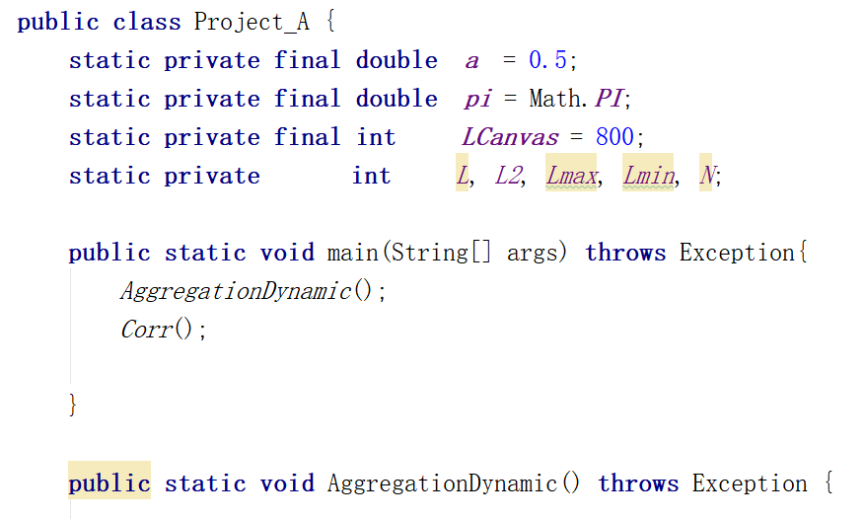
Methodolgy
2
Use Java to simulate the process.
Combine AggregationDynamic and Corr together.

Slide 5
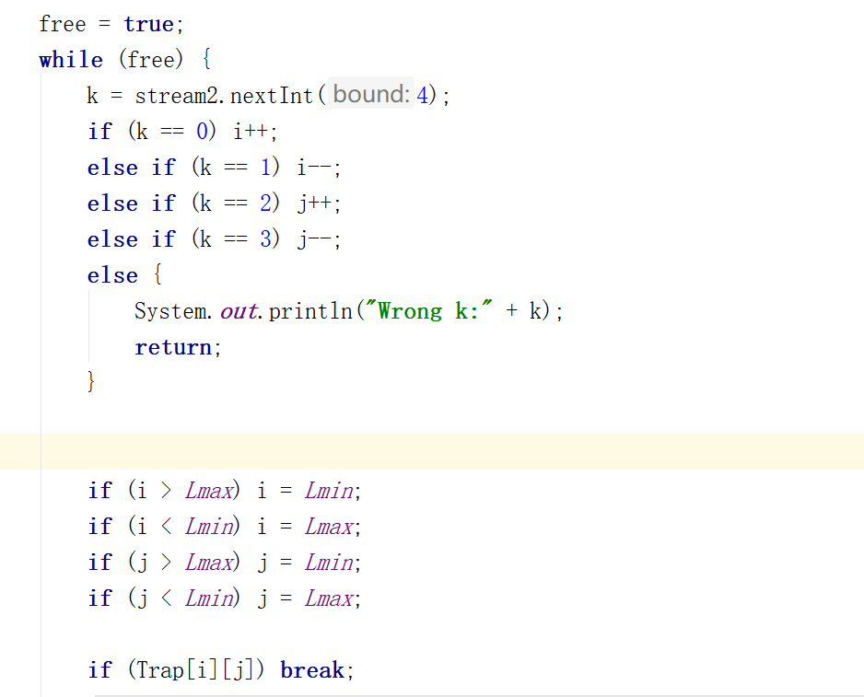
AggregationDynamic

Slide 6
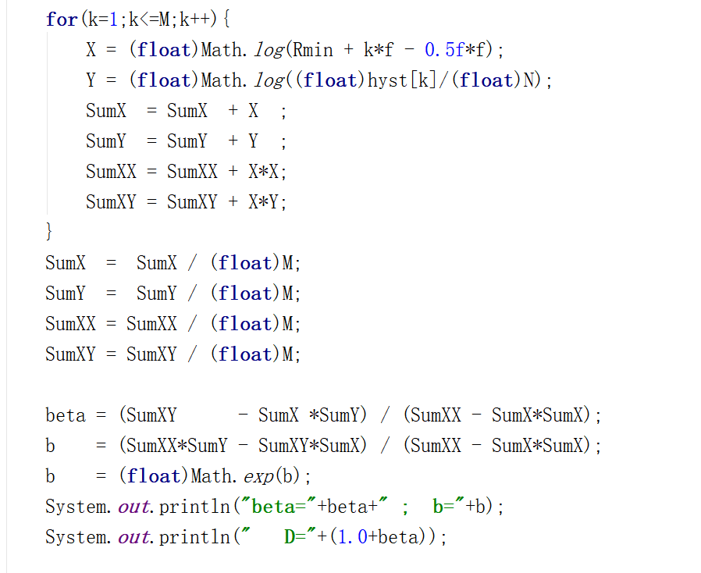
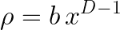
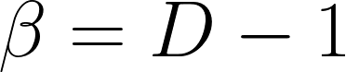
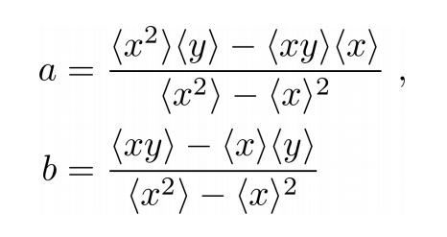
Corr
←

Slide 7
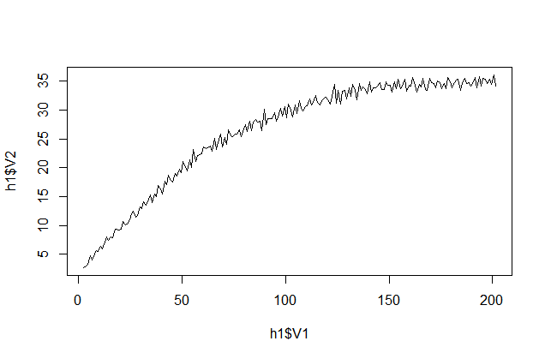
Plot
Use R studio to plot the data in h.dat.
Number of particles in the cluster: 20000;
Number of hystogram bins: 200;
Rmin=2;
Rmax=202.
beta=0.60905474
b=1.6552349
D=1.60905474

Slide 8
2020
Analysis

Slide 9
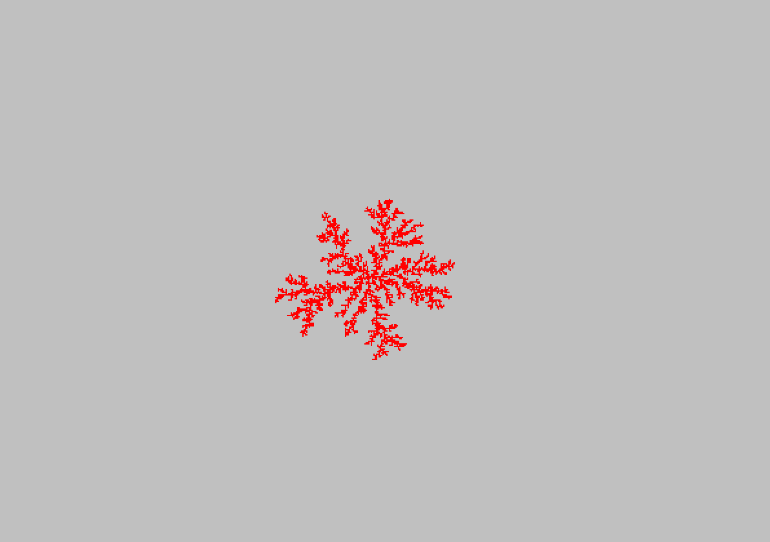
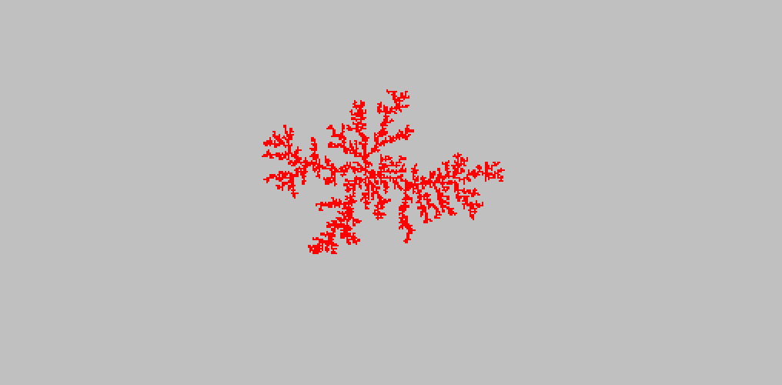
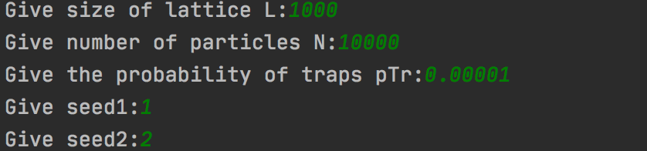
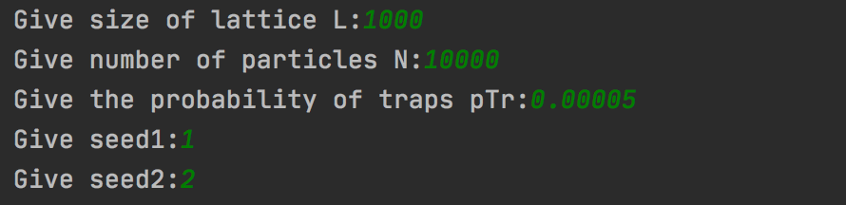
pTr = 0.00001
pTr = 0.00005

Slide 10
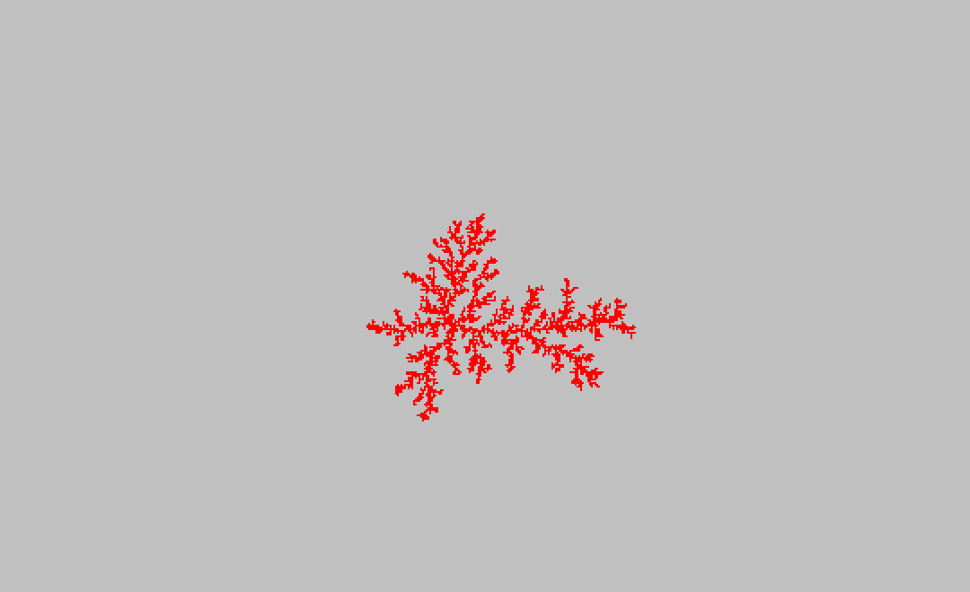
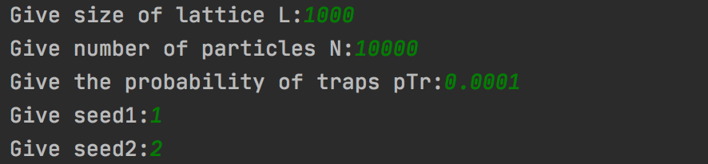
pTr = 0.0001
Picture analysis:
As we can see the three pictures, the first one is relatively symmetry, the second picture comparing the first has a trend to sprawl in the horizontal direction. In the third picture, we can indicate that the symmetry is broken, because the sprawling orientation concentrate more on the up and right.
The reason is with the pTr rising, the random moving seed is more likely to end move , break the balance and thus form a new settled seed and a new balance.

Slide 11
L=500 N=20000 Rmin=2 Rmax=202 fact=2 bins=200
pTr | beta | b | D
0.00001 | 0.4438751 | 2.8336082 | 1.44387510419
0.00005 | 0.43708012 | 2.803538 | 1.43708011508
0.0001 | 0.3938977 | 3.2447798 | 0.39389769975
As the pTr rising, the values of fractal dimension experience a decline
During the code programming, the pTr more larger , the speed more slower. The reason is when the value of pTr become larger, the computer's calculation amount increase.

Slide 12
2020
Results&Conclusion

Slide 13
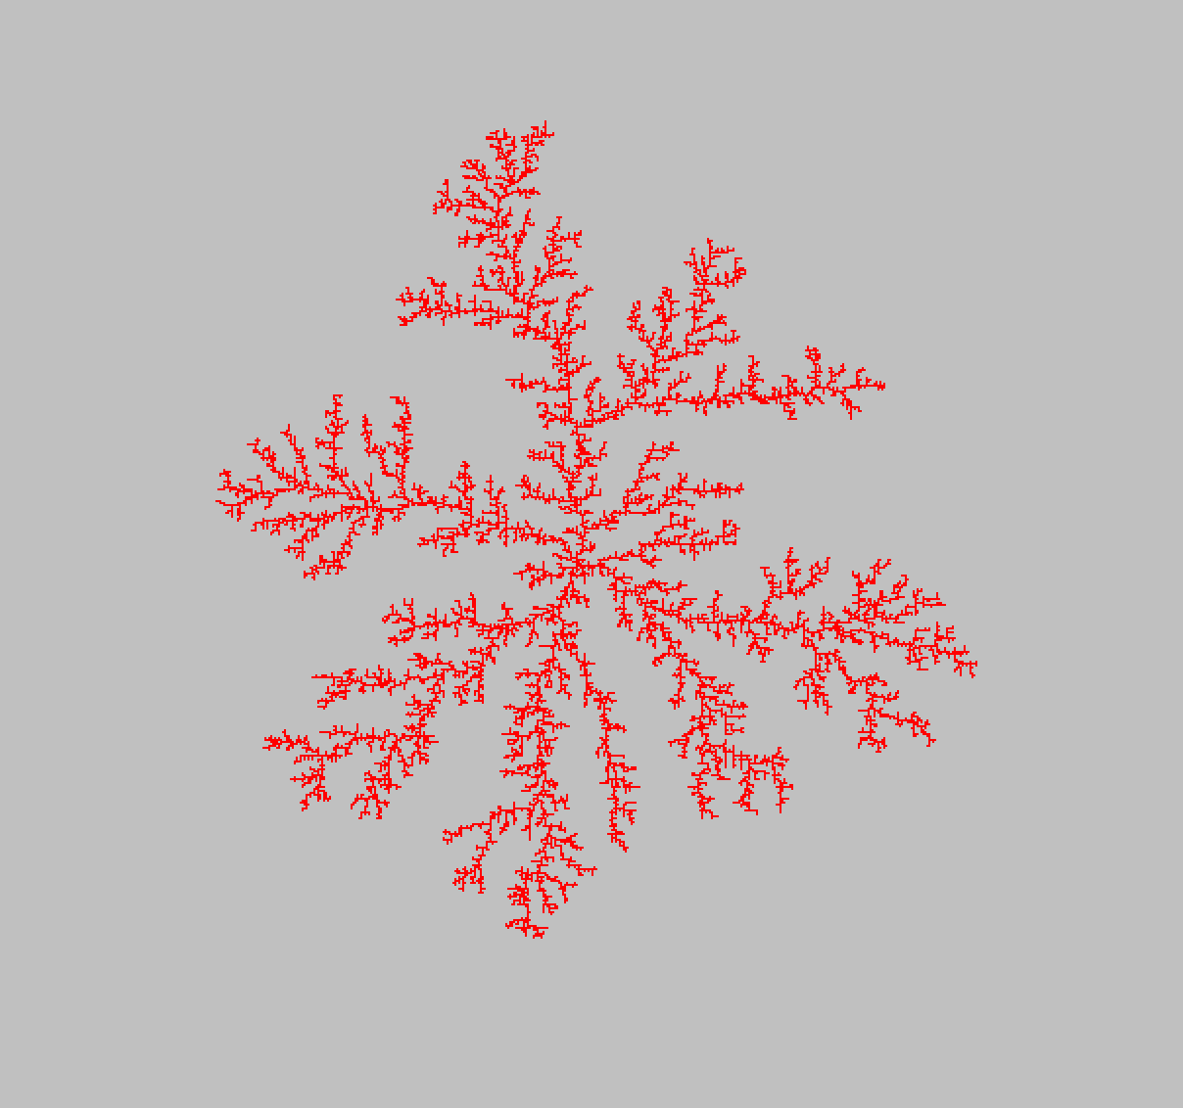
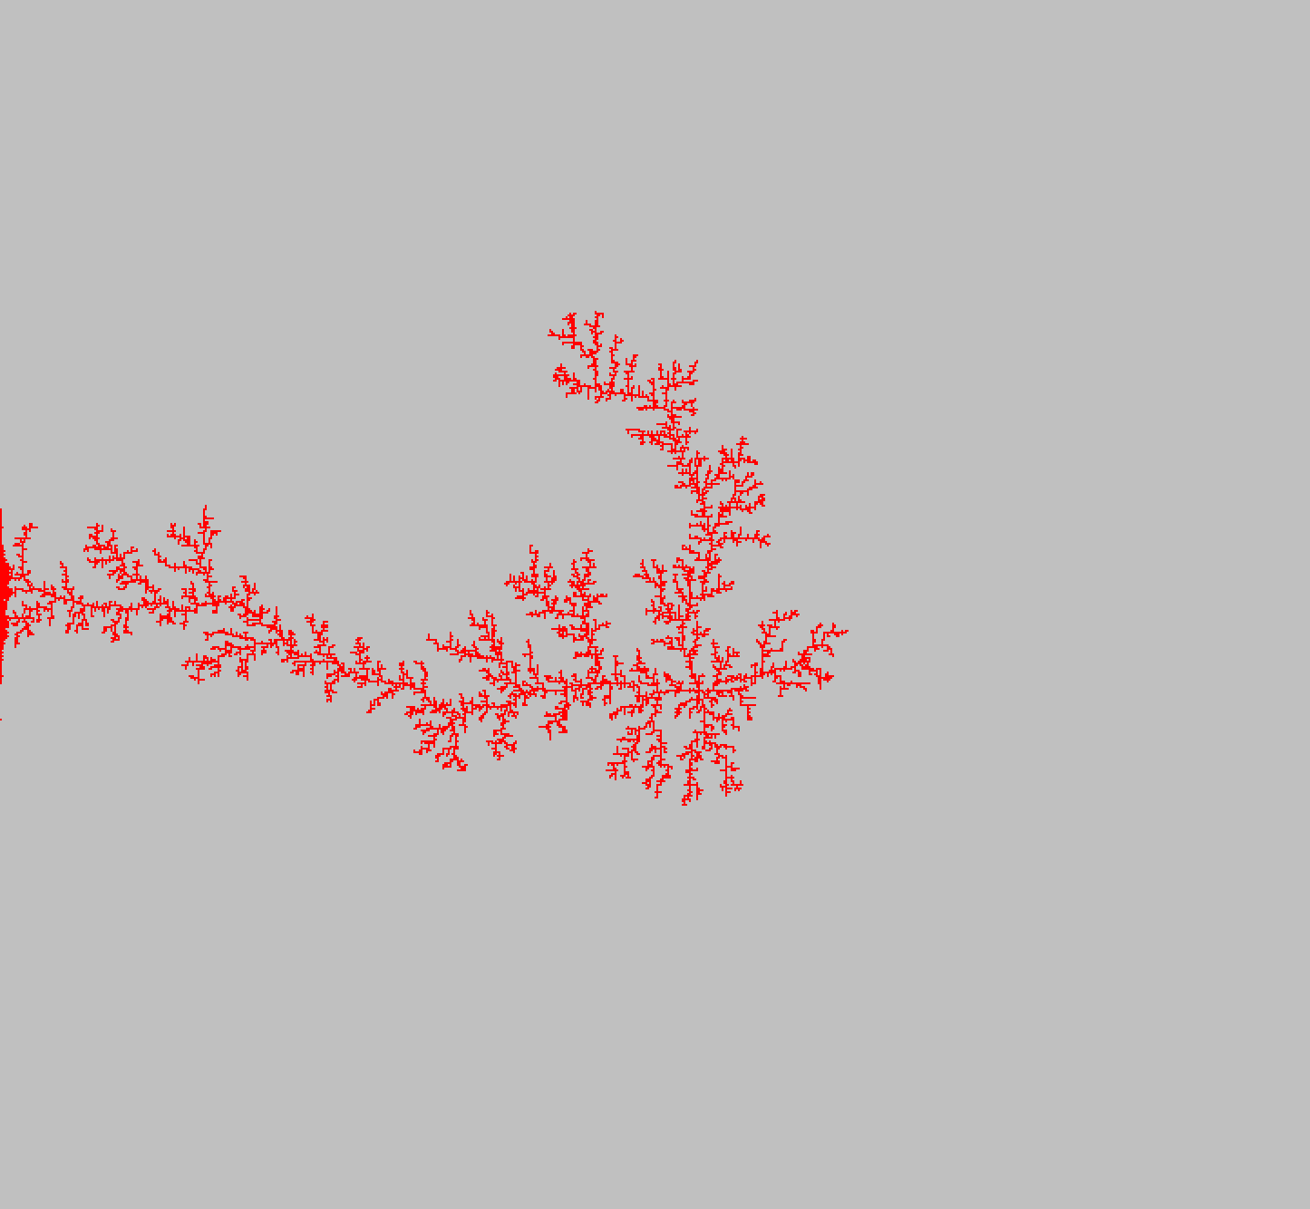
Ptr=0
Ptr=0.00025

Slide 14
D(Ptr) = -2138.7Ptr +1.6708
in [0, 0.00028]

Slide 15
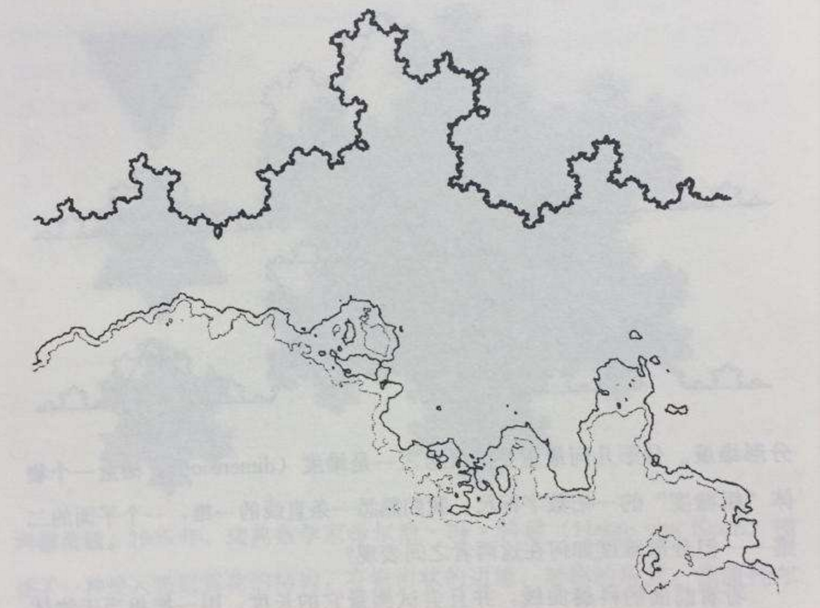
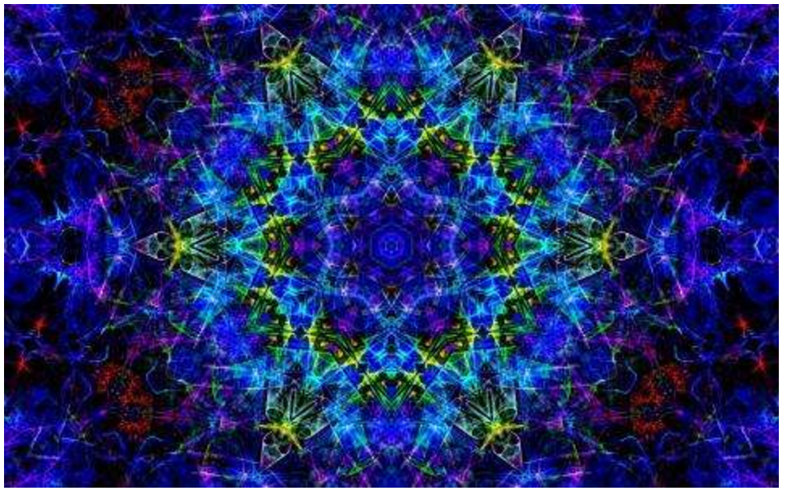
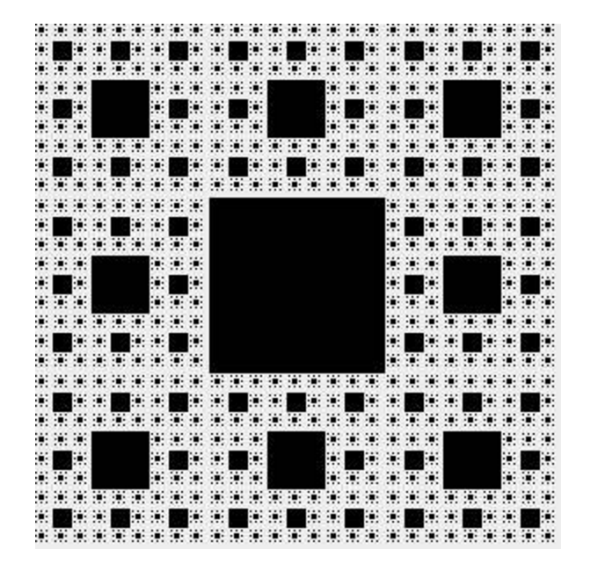
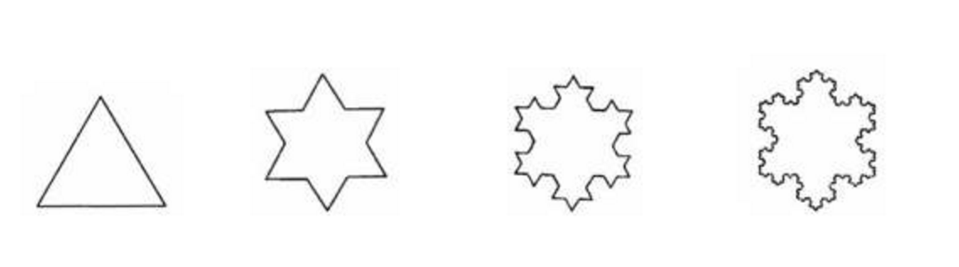
Fractal geometry

Slide 16
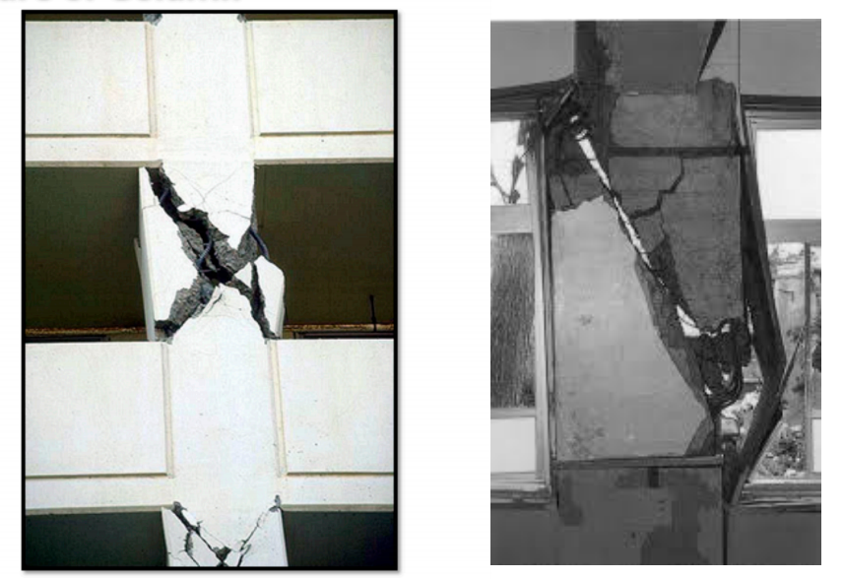
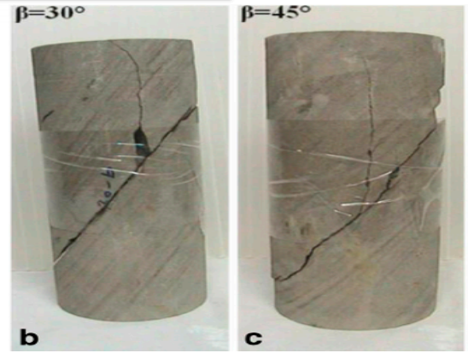
Fracture

Slide 17
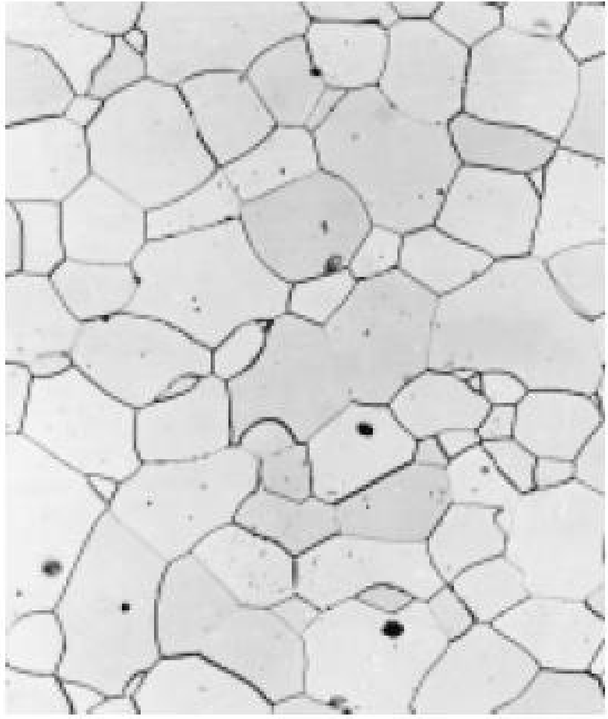
Grain boundary
Grain Boundaries – the boundary separating two small grains or crystals having different crystallographic orientation
Within the boundary region, there is some atomic mismatch in a transition from the crystalline orientation of one grain to that of an adjacent one.

Slide 18
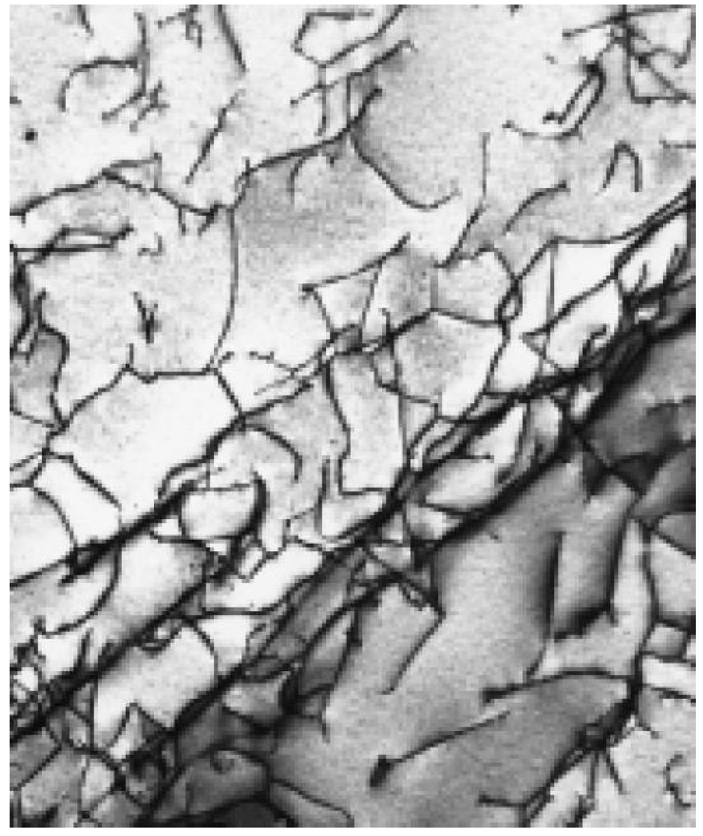
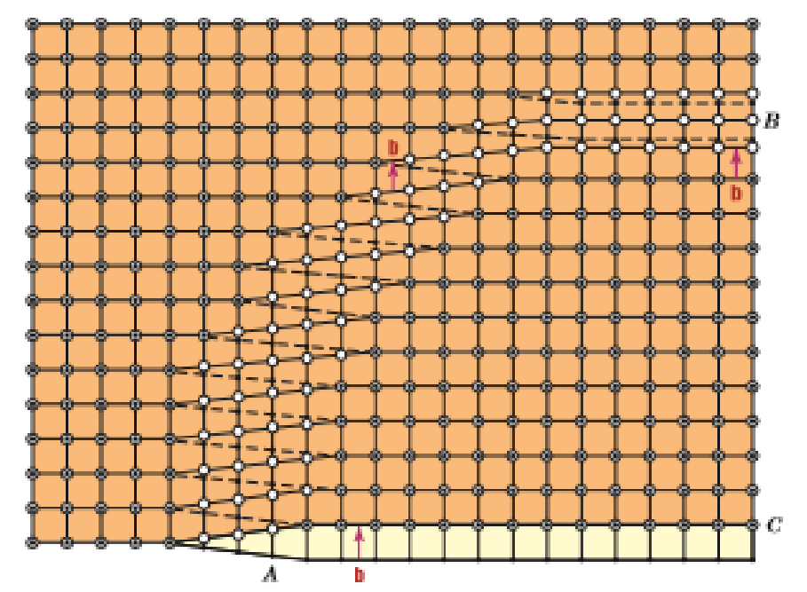
Dislocation
The nature of a dislocation (i.e., edge, screw, or mixed) is defined by the relative orientations of dislocation line and Burgers vector.

Slide 19
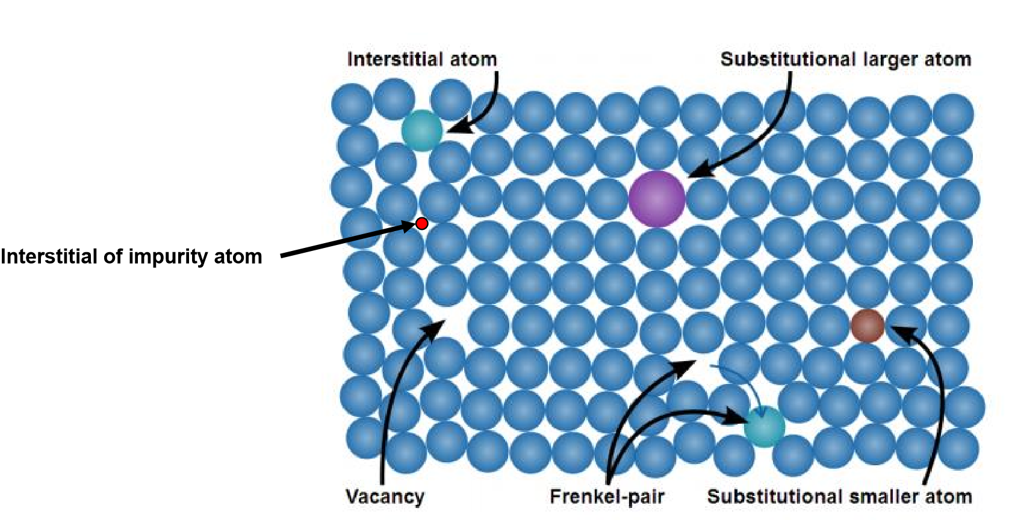
Point defects
Vacancy – atom is missing in a lattice site
Interstitial defect – insert an atom not in a lattice site
Substitutional impurity atom (larger or smaller)

Slide 20
